Slide 1

Homework Assignment for Data Analyst
Rafael Fagundes
Jul 2025

Slide 2

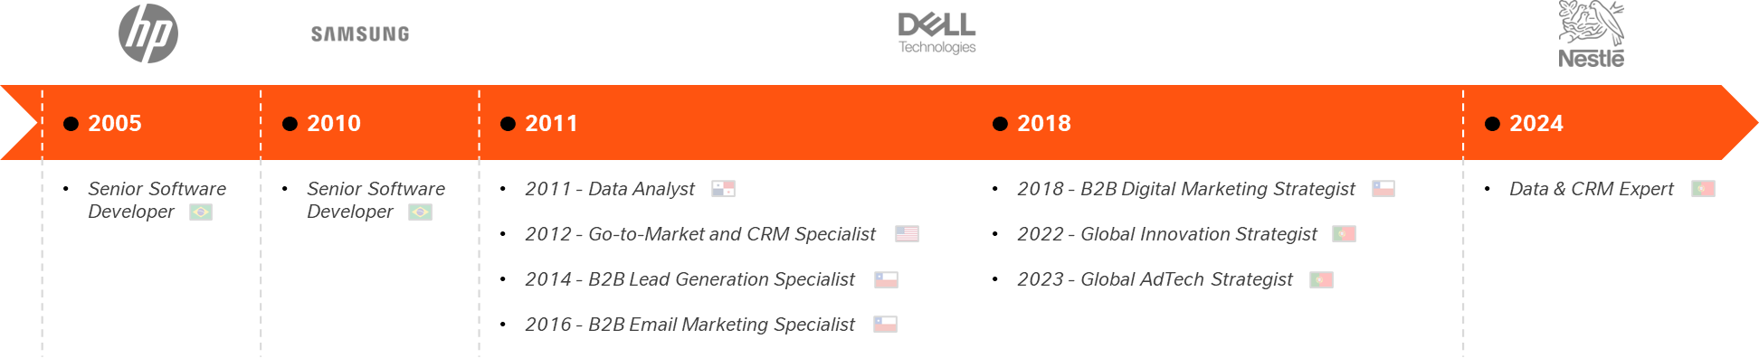
About me
Rafael Fagundes
Lisbon, Portugal
Data Analyst
linkedin.com/in/rsfagundes | rsfagundes.com
With 10+ years in data and marketing, I specialize in data-driven insights and scalable solutions using SQL, Python, and BI tools. I’m eager to help Autodoc improve dashboards, reporting, and decision-making.

Slide 3
Tools and Repository
Python – Used for Task 1: EDA, aggregation, anomaly detection, funnel visualization, and KPIs. Also used in Task 2 for validation purposes.
SQL (SQLite) – Primary tool for Task 2: Funnel metrics and validation.
Power BI – Consolidated results into an interactive dashboard.
Repository and Files:
Python Notebook: https://github.com/rs-fagundes/take-home-assessments/blob/main/Autodoc/autodoc_assessment.ipynb
SQL Script: https://github.com/rs-fagundes/take-home-assessments/blob/main/Autodoc/autodoc_assessment.sql
Power BI Dashboard: https://drive.google.com/file/d/1Lq0gciaP9lXPBs7mgJ33YOz0IM6kz4nS/view?usp=drive_link

Slide 4
Part 1
Main

Slide 5
How Users Progress Through the Purchase Funnel
Based on user navigation data, this funnel outlines the key steps in the purchase journey.
Users browsing product listings
Users viewing product details
Users showing intent to purchase
Users completing the purchase
100%
Listing Page
180,9k
90%
Product Page
162,8k
5%
Add to Cart
8,9k
4%
Order
7,6k
Key Insights | Recommendations
Most users start on listing pages; search plays a secondary role. | Optimize CTAs, reviews, and pricing transparency.
Large drop-off after product pages suggests UX, trust, or pricing barriers. | Improve post-product page experience to drive cart actions.
Conversion from add-to-cart to order is steady but low. | Streamline checkout and enhance value proposition.

Slide 6
Key Metrics to Monitor and Improve User Engagement
These KPIs provide a clear view of user engagement, intent, and conversion barriers.
They help track performance over time, highlight areas where marketing or UX improvements can drive impact, and serve as key metrics for ongoing performance monitoring.
Category | Key Metrics / Data | Purpose / Insight
Page View Distribution per Page Type | % of sessions visiting each main page type (Product, Listing, Search) | Understand where user attention is focused
Add-to-Cart Rate per Page Type | % of sessions adding products to cart after viewing product or listing pages | Reflects user engagement and intent to purchase
Order Conversion Rate | % of sessions that complete a purchase | Core metric to evaluate funnel effectiveness
Drop-off Rate Between Steps | % of users abandoning after each stage (view to add-to-cart, add-to-cart to order) | Identifies weak points in the user journey
Most Common Navigation Paths | Top 5-10 most frequent user journeys through the site | Provides clarity on typical user behavior patterns

Slide 7
Missing Data That Limits Strategy Evaluation
Without data on revenue, source, and segmentation, it’s not possible to measure the strategy’s effectiveness beyond user behavior.
To optimize or validate decisions, it’s essential to connect behavior with business outcomes.
CATEGORY | KEY METRICS / DATA | PURPOSE / INSIGHT
Revenue / Profit Metrics | Revenue per session, AOV, Margin | Connect behavior to business impact
Acquisition Source | Paid, Organic, Direct, Referral | Identify high-conversion channels
Segmentation Data | New vs. Returning; Demographics; Behavior | Clarify audience differences
Cart Abandonment | % Abandoned carts; Reasons (if available) | Identify friction points
Performance Over Time | Weekly / Monthly trends | Assess strategy impact over time
Product Performance | Conversion by category, brand, SKU | Optimize by product type

Slide 8
Impact of Entry Pages on Engagement and Conversion
This analysis maps how entry pages influence user behavior and funnel performance.
Product and search pages drive higher engagement and conversions than listings, a key input to optimize UX and acquisition.
First page type | Page viewed | Added to cart | ordered | Page view distribution % | Add to cart rate % | Order conversion rate % | Drop off rate %
listing_page | 176.8k | 3.1k | 2.4k | 52.1% | 1.7% | 1.3% | 98.7%
product_page | 146.9k | 6.6k | 3.3k | 43.3% | 4.5% | 2.3% | 97.7%
search_listing_page | 15.3k | 1.0k | 539 | 4.5% | 6.8% | 3.5% | 96.5%
*Order pages were excluded as entry points because they do not represent a natural starting point in the user journey. The analysis focuses on pages where users actively begin exploring products.

Slide 9
Part 2
SQL

Slide 10
High Volume of Users Only Viewing Products in Their First Session
15k-24k daily users view products without taking action
Low engagement signals potential UX or incentive gaps
Recommend optimizing CTAs and testing re-engagement strategies
*Average benchmark calculated over the full period.

Slide 11
Unusual Orders Without Page Views or Cart Activity
3.4k sessions placed orders without any page views or cart activity
May indicate a tracking gap or a direct checkout flow bypassing standard pages
Further investigation is recommended to confirm root cause

Slide 12
Appendix

Slide 13
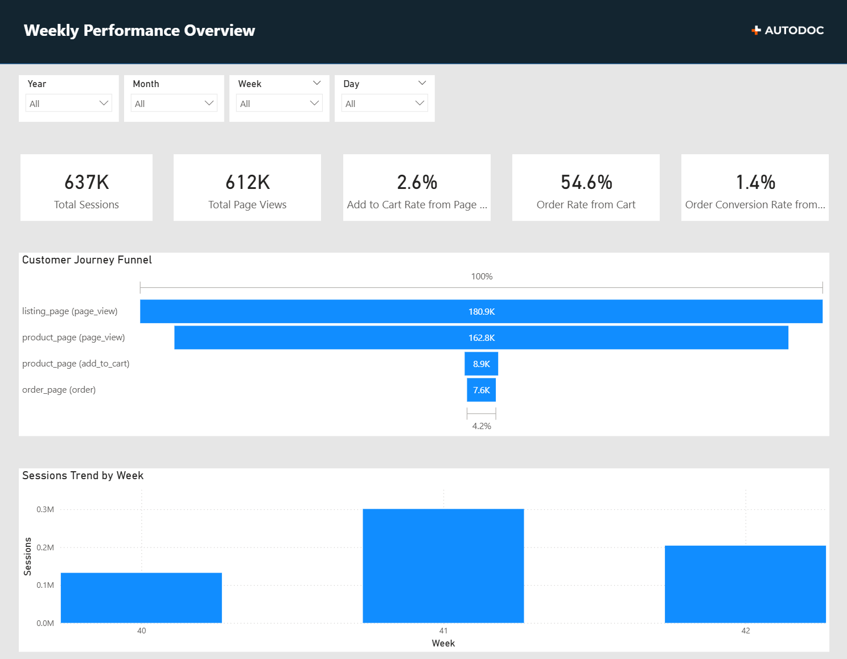
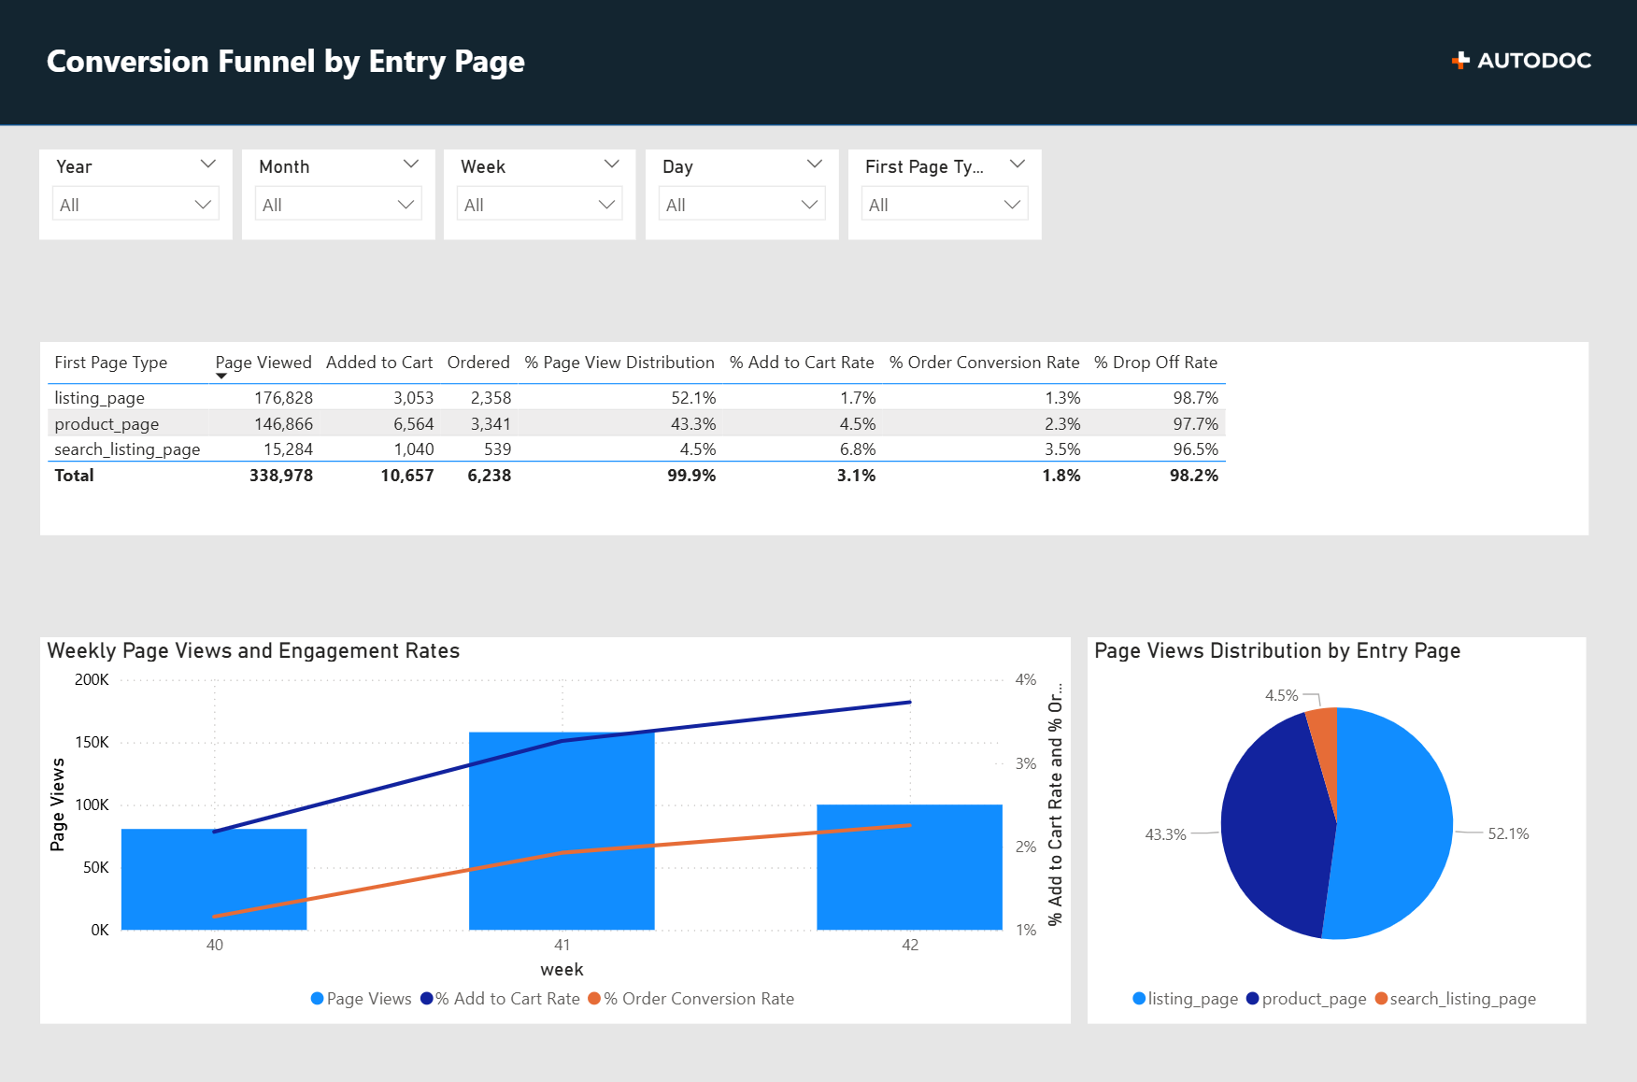
Power BI Dashboard
Link to Power BI Dashboard

Slide 14
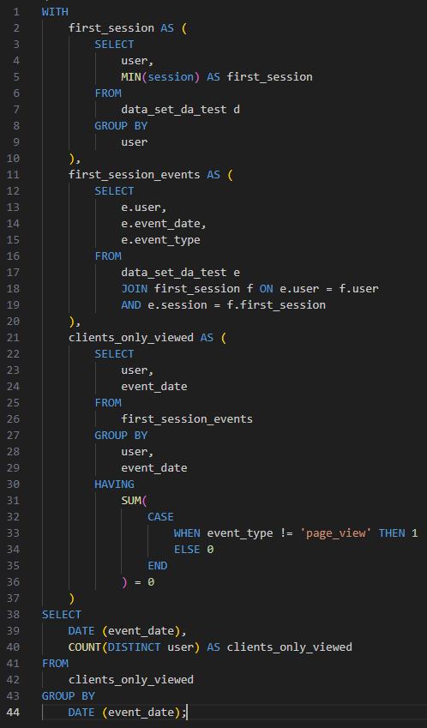
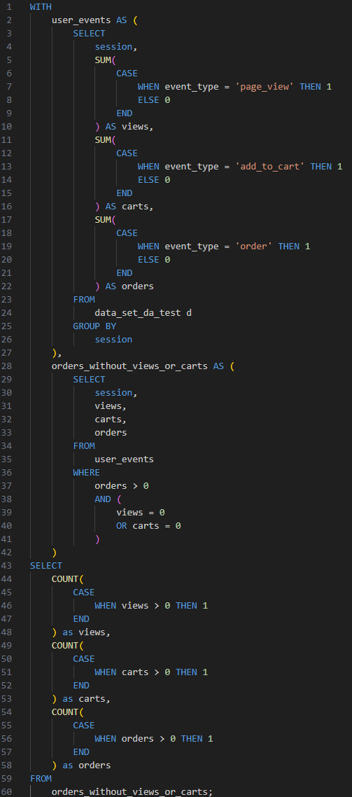
SQL Script
Link to SQL Script
Exercise 1
Exercise 2

